Slide 1
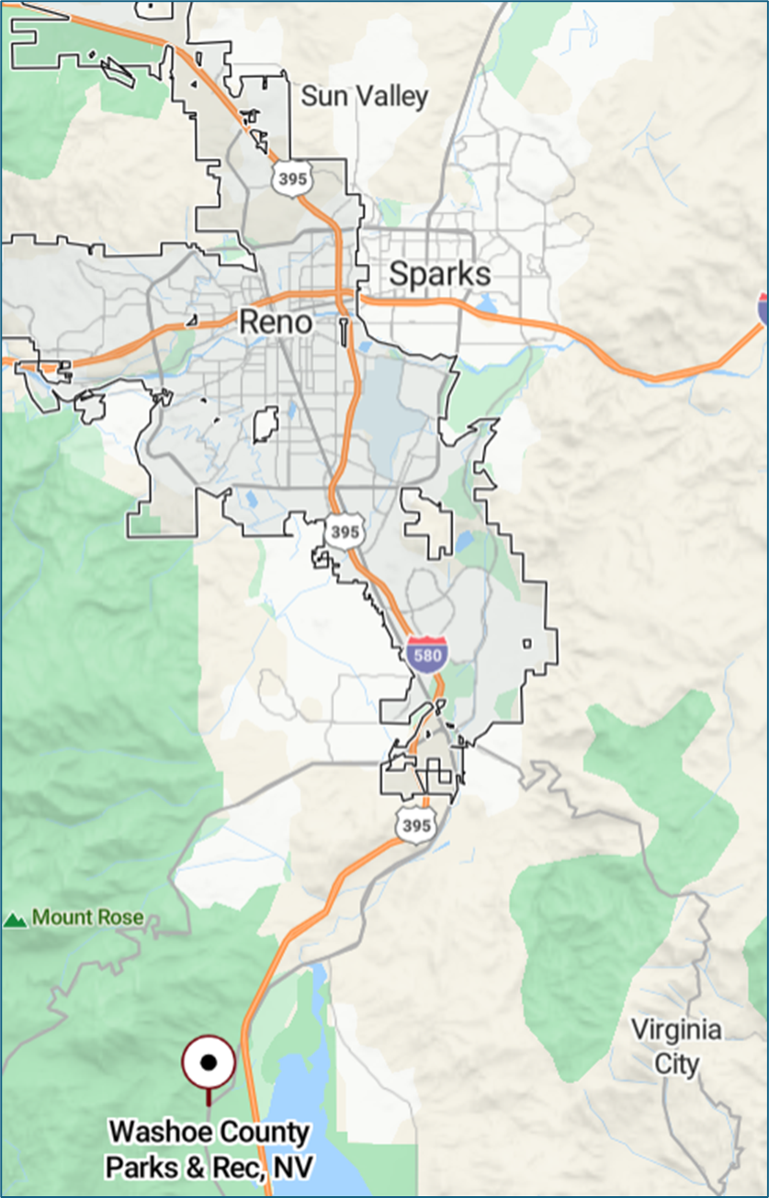





Service Plan Feasibility Study

Slide 2

Agenda
Feasibility Study Progress & Meeting Objectives
The Case for a Special Service District
Stakeholder Interviews
Survey Results
Level of Service Analysis
Operational Assessment
Establishing a Special Service District
Summary of Findings & Guiding Principles
Next Steps Discussion

Slide 3
Progress Update – Where are we today?
Project kickoff and initial site tours for each system
Conducted Stakeholder and Focus Group Interviews, including staff, to identify key findings and themes
Completed Demographics and Recreation Trends Analysis
Administered two surveys: Statistically-Valid, Random Sample and Online Community Survey
Collected inventory from each agency and conducted multiple Level of Service Analyses
Began an Operational Assessment of current KPIs for each agency
Developed The Case for a Special Service District
Ongoing collaboration and project coordination with the 4 key agencies

Slide 4
Meeting Objectives & Groundrules
Today’s objective is to update City/County leaders on our progress to date, share key findings for consideration, and clear up any questions
Now that findings have been compiled, we will present the case for forming a Special Services District and discuss what that framework will entail
We are not here to make final decisions or to have all the answers today
There will be unknows that persist that will be established as part of the Service Plan development – i.e. boundaries, how will property transfer, how will employees transition and be treated, what programs and services will move, what does funding look like, etc.
The goal is to provide evidence gathered that supports establishing a Service District and provide information that will enable the respective Commissions to understand where we are today and what is next so they can make an informed decision on whether to pursue the formation of a Special Services District

Slide 5
The Case for a Special Service District

Slide 6
The Case for a Special Service District
Strong and measurable public support for a regional approach
~70% of residents believe a single district would improve efficiency and service quality, and a majority are likely to vote in favor, with support consistent across Reno, Sparks, and Washoe Co.
Nearly two‑thirds support a dedicated funding source, signaling readiness for long‑term investment.
Clear demand for equity and consistency in parks and recreation
Most residents believe park services are not consistent across neighborhoods, while 94% say equitable access is essential - highlighting a core role for a district to standardize service levels and outcomes.
Current funding and service levels vary widely across jurisdictions
Per‑capita investment ranges from $21 to $58, well below the NRPA median of $77, creating disparities in maintenance, staffing, and amenities.
A shared district offers a framework to rebalance investment and align spending with national benchmarks.
Notes:
Public support: Community survey results show strong support for creating a special parks district, with a majority believing it would improve efficiency and service quality. Voter support appears consistent across jurisdictions.
Uneven service & funding: Per‑capita spending and service levels vary widely between municipalities and the county, leading to inequities in maintenance quality, amenities, and programming.
Operational efficiencies: A regional district enables economies of scale—shared staffing models, coordinated planning, consolidated purchasing, and standardized maintenance practices.
Maintenance first: Stakeholders and residents consistently prioritize taking better care of existing parks before adding new ones; current funding structures make that difficult.
Why a district: A special district provides a stable, dedicated funding mechanism and a governance structure focused solely on parks and recreation—something no single jurisdiction can achieve alone.

Slide 7
The Case for a Special Service District
Operational efficiencies and economies of scale are achievable
Consolidated planning, asset management, staffing models, and purchasing can reduce duplication and stretch limited dollars further than siloed systems.
Shared facilities and programming respond to region‑wide demand for similar amenities.
Maintenance and asset stewardship are a top priority
Stakeholders and the public agree: maintaining existing parks must come before expansion.
A regional district creates stable, dedicated funding and coordinated standards to protect existing investments before adding new ones.
Why a district?
A Special Services District is the most effective way to deliver equitable, well‑maintained parks for all residents by aligning public support, stabilizing funding, and capturing efficiencies that no municipality can achieve alone.
Notes:
Public support: Community survey results show strong support for creating a special parks district, with a majority believing it would improve efficiency and service quality. Voter support appears consistent across jurisdictions.
Uneven service & funding: Per‑capita spending and service levels vary widely between municipalities and the county, leading to inequities in maintenance quality, amenities, and programming.
Operational efficiencies: A regional district enables economies of scale—shared staffing models, coordinated planning, consolidated purchasing, and standardized maintenance practices.
Maintenance first: Stakeholders and residents consistently prioritize taking better care of existing parks before adding new ones; current funding structures make that difficult.
Why a district: A special district provides a stable, dedicated funding mechanism and a governance structure focused solely on parks and recreation—something no single jurisdiction can achieve alone.

Slide 8
Stakeholder Interview Summary

Slide 9
Stakeholder Interviews
Methodology
A series of Stakeholder Interviews and Focus Groups that included more than 40 individuals were conducted for Reno, Sparks, and Washoe County to gauge interest and gather feedback on the potential formation of a Special District.
  City / county government officials and staff
  Various user groups (e.g. sports groups, special interest, trail users, etc)
  Local business / organization leaders
  Park and non-park users
Interview Objectives
Identify pros / cons of forming a Special Service District and gain perspective from key stakeholders from the various entities of the potential joint partnership

Slide 10
Stakeholder Feedback – Key Themes
Equitable Governance & Representation
Strong desire for fair decision-making, funding allocation, and protections for smaller jurisdictions.
Sustainable & Transparent Funding
Dedicated funding sources, clear cost–benefit analysis, and concerns over tax impacts.
Operational, Legal & Cultural Complexity
Challenges merging staff, labor agreements, service boundaries, and organizational cultures.
Consistency of Services & Quality
Risk of uneven service levels or diluted recreation quality across a larger district.
Maintenance Before Expansion
Strong preference to address deferred maintenance before adding new facilities.
Preservation of Community Identity & Local Control
Desire to retain unique character, programming, and responsiveness to local needs.
Public Trust, Buy-In & Social Challenges
Need for transparency, outreach, and coordinated approaches to safety and homelessness.

Slide 11
Survey Results

Slide 12
Statistically Valid Survey
Survey Description
Five-page survey + a cover letter were mailed to random sample of households in Washoe County
Method of Administration
By mail and online with options to complete the survey over the phone
Sample Size
748 total surveys
  Reno: 400, Sparks: 184, Washoe County Outside Reno/Sparks: 164
Margin of Error
+/- 3.6% at the 95% level of confidence

Slide 13
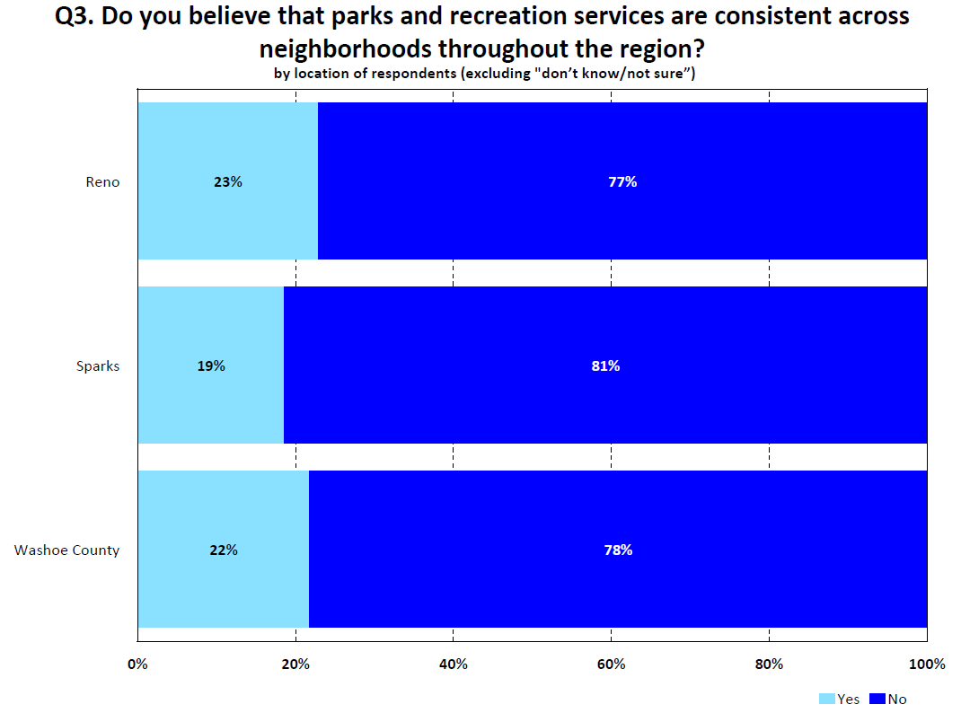
Most respondents, regardless of where they live believe park services are NOT consistent across neighborhoods

Slide 14
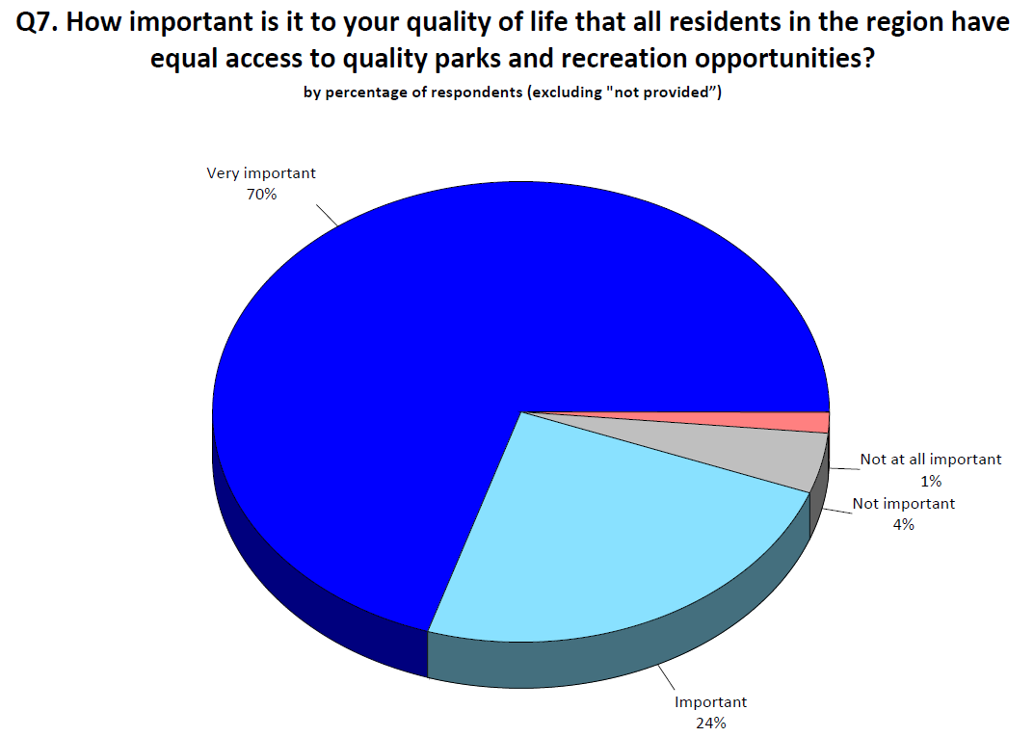
By Area:
Reno: 96% Importance
Sparks: 94% Importance
Washoe County: 91% Importance
Most (94%) of respondents believe it is important to have equal access to parks and rec opportunities

Slide 15
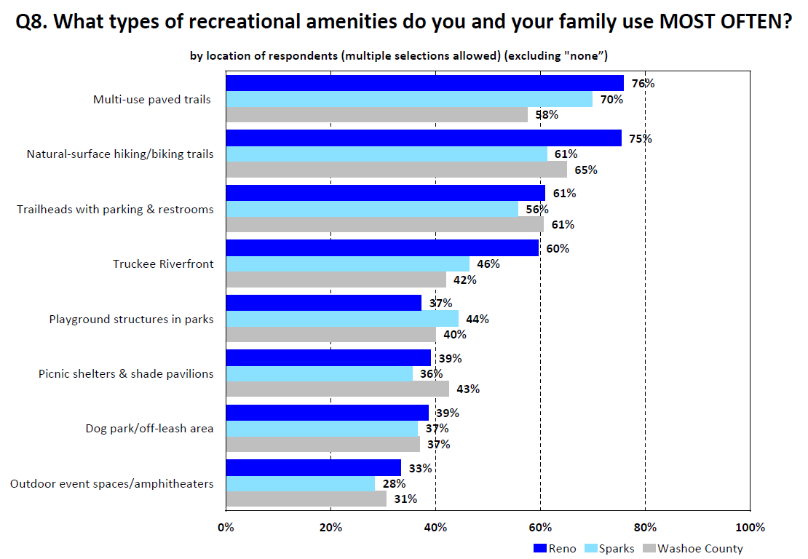
Regardless of the area most respondents prefer the same recreational amenities that were listed

Slide 16
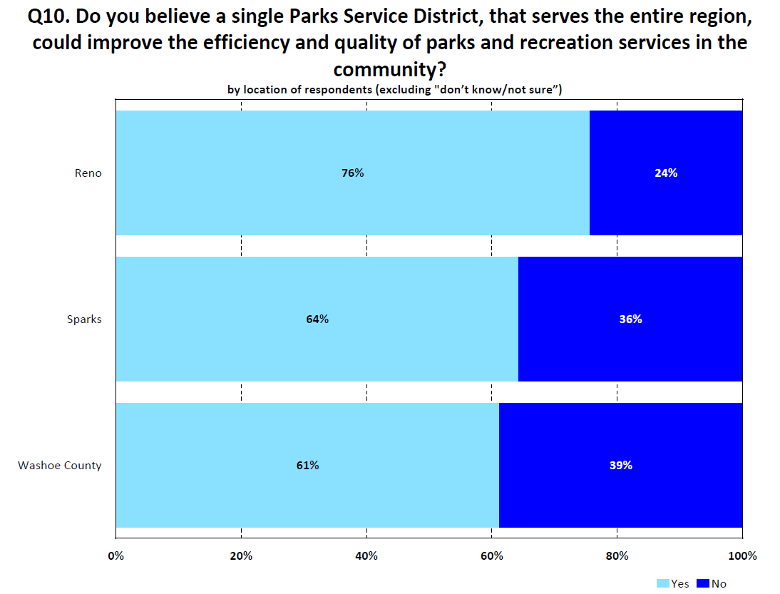
Overall Ratings
Yes: 70%
No: 31%
Most respondents – regardless of area – believe that a single district could improve efficiency and quality

Slide 17
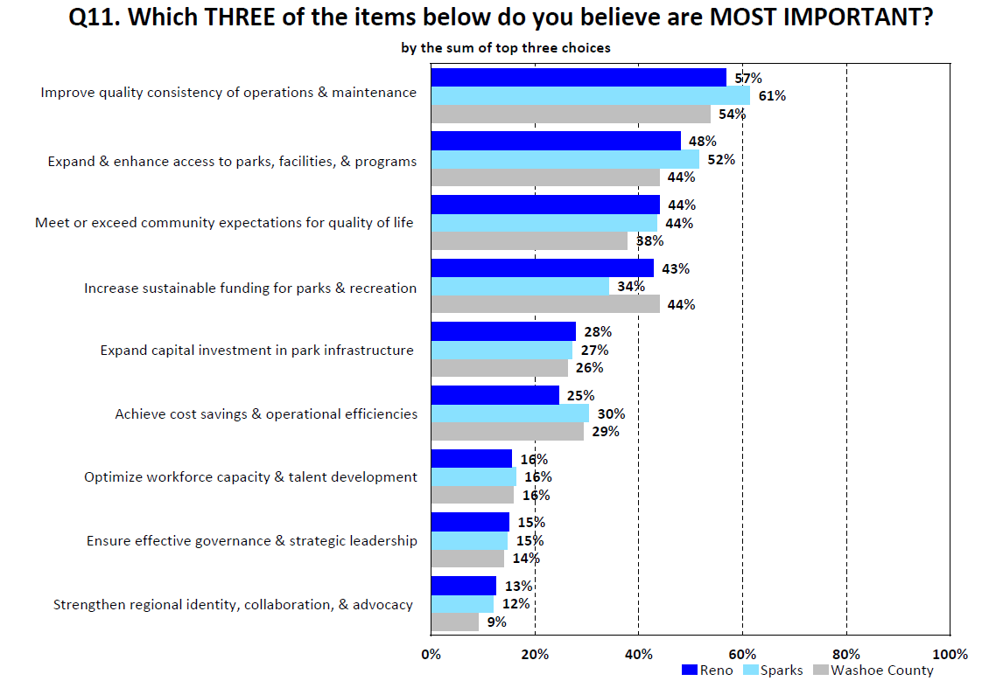
There is strong alignment with the most important improvements that a single district could offer

Slide 18
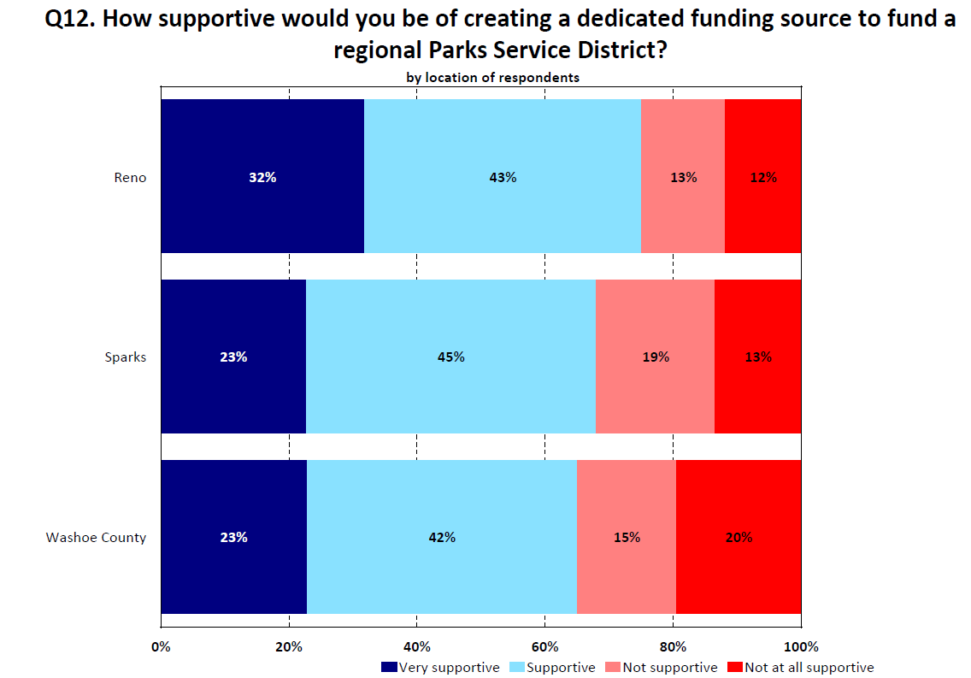
Overall Ratings
Very Supportive: 28%
Supportive: 44%
Not Supportive: 14%
Not at All Supportive: 14%
There were no significant differences based on voter registration or propensity to vote

Slide 19
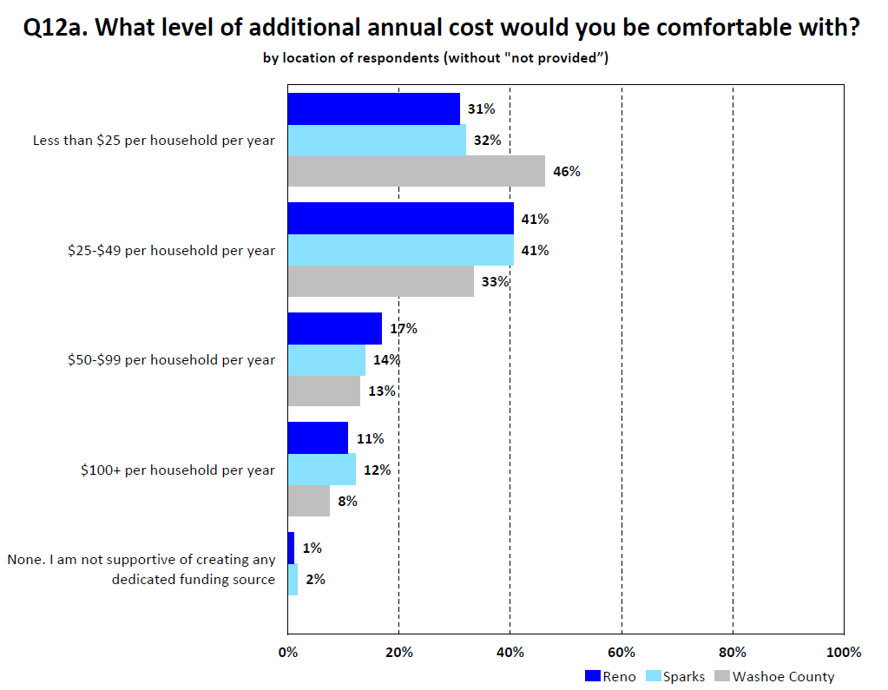
Most Respondents would be comfortable with $25 or more per household per year
Reno: 69%
Sparks: 67%
Washoe County: 54%
There were no significant differences based on voter registration or propensity to vote

Slide 20
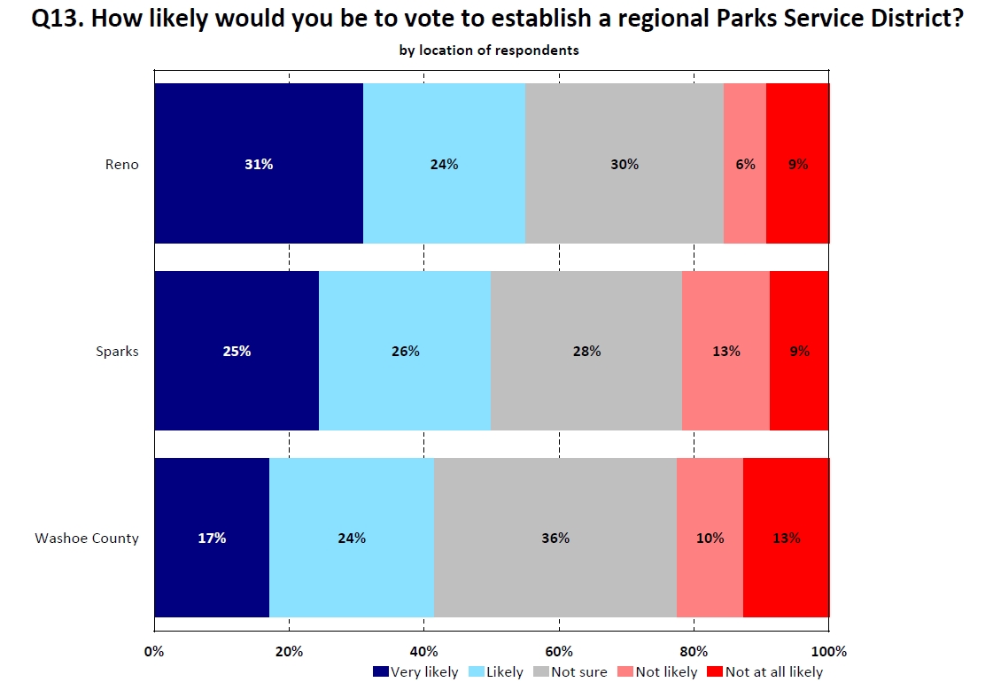
Very Likely + Likely + ½*Not Sure =
Reno: 70%
Sparks: 65%
Washoe County: 55%
There were no significant differences based on voter registration or propensity to vote
Overall, a good proportion of respondents are “very likely” or “likely” to vote in favor

Slide 21
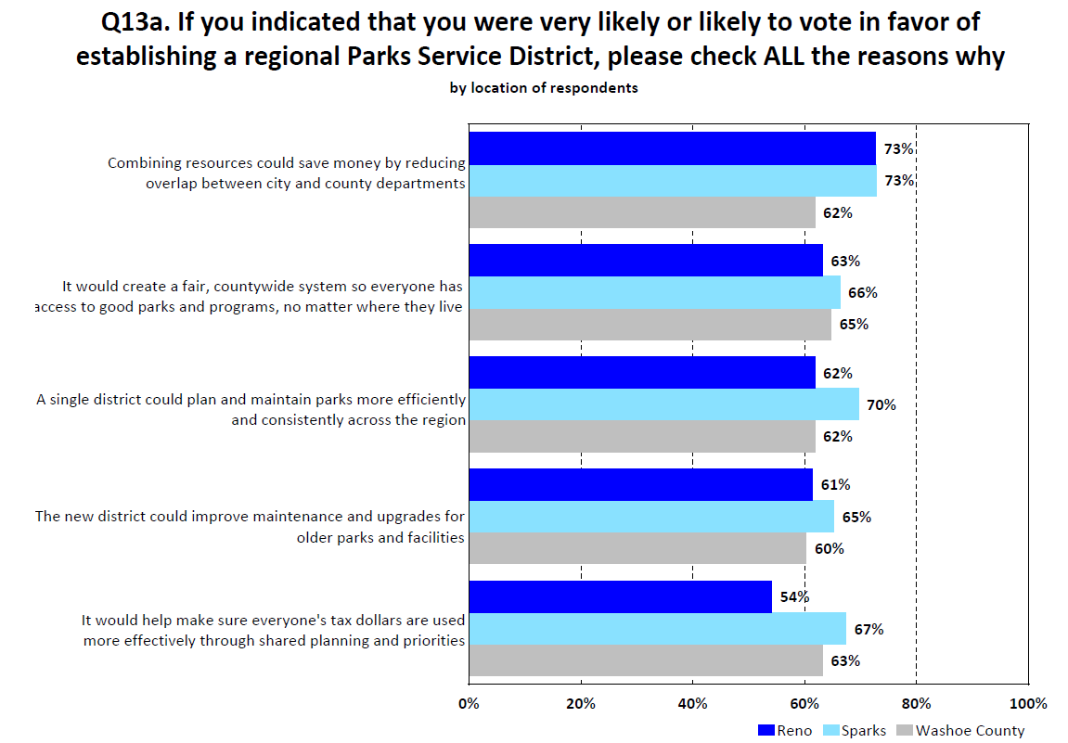

Slide 22
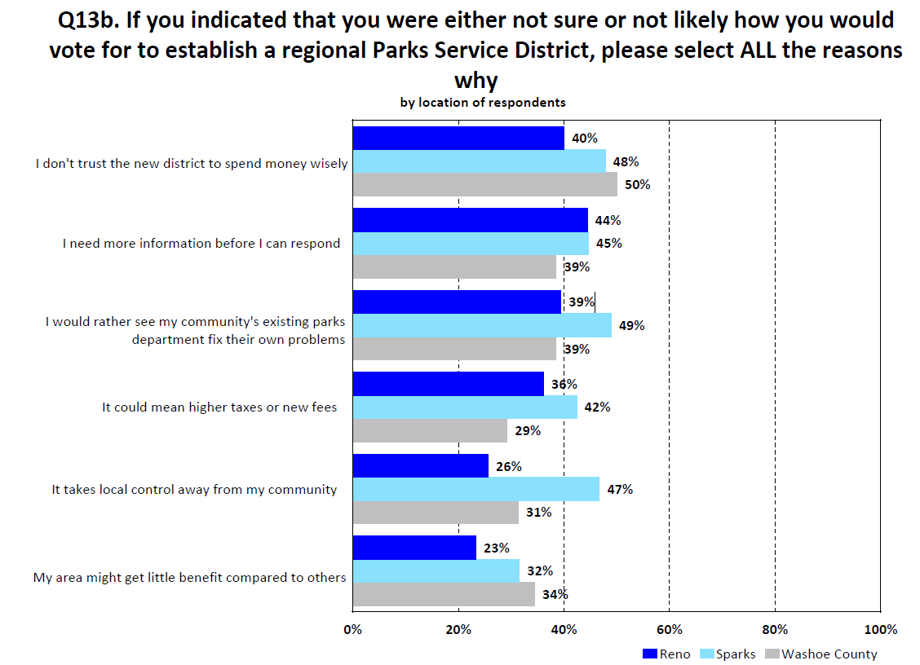
Reasons respondents might vote against establishing a regional service district

Slide 23
Online Survey
In addition to the statistically valid survey, a second survey was conducted that could be accessed online by the general population
A total of 502 online survey responses
Strong alignment between the survey responses and there is similar levels of favorable support for creating a dedicated funding source and likeliness to vote in favor of establishing a regional Parks Service District
However, the online survey indicated respondents desired lower levels of funding in terms of annual household spend to support the District
Respondent demographics vary significantly for the two surveys and the online respondents do not align with the composition of Washoe County residents
Data from the online survey should not supersede the statistically valid set

Slide 24
Level of Service Analysis

Slide 25
Level of Service

Slide 26
Operational Assessment

Slide 27
Operational & Capital Costs
2025 NRPA Medians: Per Capita Investment = $77.34 (excluding earned income) / CR = 27%

Slide 28
Staffing
2025 NRPA Medians: Operating Expense per FTE = $118K / FTEs per 10K Residents = 8.6

Slide 29
Maintained Acreage

Slide 30
Establishing a Special Service District

Slide 31
Nevada Parks, Trails and Open Space Districts
In project survey majority of respondents indicated they would be supportive of forming a regional Parks District
Also 2/3 of respondents supported a dedicated revenue source for a regional Parks District
Such a District is Authorized by Nevada Revised Statutes (NRS) 318A
Petition for formation can be submitted by cities and counties within proposed boundary
Petition must include a “Service Plan”
NOTE – No Districts have been formed in Nevada under NRS 318A

Slide 32
Service Plan – NRS 318A.090
Before determining whether to create the District a Service Plan must be created, the Service Plan must specify:
  How proposed services are to be provided and financed
  Map of the proposed district including the population and assessed valuation
  Description of the facilities and improvements or projects to be constructed and the services to be provided, including annual operations and maintenance costs and other expenses including debt service costs
  Any agreements or proposed agreements between the proposed District and any city or county within the boundary of the District for proposed services
  Service plan must be filed with each local government in the District and is subject to public hearing requirements

Slide 33
Public Hearings – NRS 318A.120
Any governing body that is considering creating a District shall hold a public hearing and consider approval after taking public comments
If there is a county planning commission or regional county planning commission each such commission shall study the service plan and present its recommendations to the governing body at a public hearing
The service plan may be approved, disapproved or modified
A District may not be formed if a majority of property owners within the proposed district submit protests
All local governments within a District must consent to creation of a District
If the boundaries of the proposed District overlap with one of more general improvement districts and the GID has not consented, the District may not be formed

Slide 34
Formation – NRS 318A.170
Formation is accomplished by adoption of an ordinance by the governing body including
  Accounting practices and procedures
  Auditing practices and procedures
  Initial budget
  Management standards
First Board of Trustees (5 members)
  Appointed by counties and cities within the District
  Determine by lot which serve 2- and 4-year terms
  Then biennial elections

Slide 35
Powers – NRS 318A.300
Acquire, construct and improve projects for parks, trails and opens space
Such facilities may include playgrounds, ball parks, public parks, beaches, marinas, gymnasiums, trails, open spaces and many other named types of recreation and park facilities
Any local government located within the boundary of the District may contribute revenues / facilities to the District
The District may levy fees and assessments
Subject to an agreement with the County a District may levy ad valorem taxes
Subject to some limitations a District may issue debt including general obligation, revenue and special assessment bonds

Slide 36
Summary of Findings & Guiding Principles

Slide 37
Summary of Key Findings
90%+ of residents highly value parks & recreation & equal access
Residents of Reno, Washoe and Sparks currently use parks as a regional system
Growing community of younger families will increase demand on park systems
Residents overwhelming support formation of a District and believe it could improve the quality of Parks and Recreation.
Most important issue to residents is improving quality, consistency and access to parks and recreation
Challenges to fund & develop needed capital improvements
Current level of services provided are below national average
  Expenditures per capita on parks and recreation
  Workers allocated per acre to maintain developed parks and facilities.
  Developed park acres and some key facilities per capita

Slide 38
Guiding Principles & Goals
District must achieve service levels equal or better than currently provided.
Cities & County should fund District at current budget levels via agreement.
Cities & County should investigate forming Joint Powers Authority to fund District
JPA can contract for services at their parks, facilities, trails, open space and lands
District budget should include new tax funding to augment JPA funding.
Transitional structure for agencies of a “dependent district” to guide control.
A Service Plan Should Identify
  Consistent & acceptable level of service standards– particularly maintenance
  Consolidate organization structure – classifications, allocations, compensation
  No layoffs of existing personnel
  Strategies for enhancing or developing park improvements through CIP & funding.

Slide 39
Next Steps

Slide 40
What’s Next – Defining the District Framework
Service Framework Development (Month 1)
Define a clear menu of services (operations, maintenance, programming, capital delivery) with baseline service standards applied equitably across the district.
Identify which services launch on Day One versus phased implementation.
District Boundary & Participation Options (Month 1)
Confirm proposed district boundaries and evaluate participation scenarios (members, phased entry, service contracts).
Analyze population, assessed value, and asset contributions for each jurisdiction.
Funding & Governance Structure (Month 2)
Evaluate dedicated revenue options aligned with voter tolerance and statutory authority.
Develop a governance model focused on equitable representation, transparency, and local identity protection.
Asset & Staffing Transition Planning (Month 2)
Define how existing assets and staff transition or are managed through agreements without reducing current service levels.
Establish maintenance and capital prioritization strategies based on need, condition, and equity.
Service Plan & Engagement Milestones (Month 3)
Build the statutorily required Service Plan (NRS 318A), supported by financial modeling and public outreach.
Engage elected officials, park boards, and the public early to refine assumptions and build confidence before formal adoption steps.

Slide 41
Thank You!
Questions?

Slide 42
Appendix

Slide 43
Demographics

Slide 44
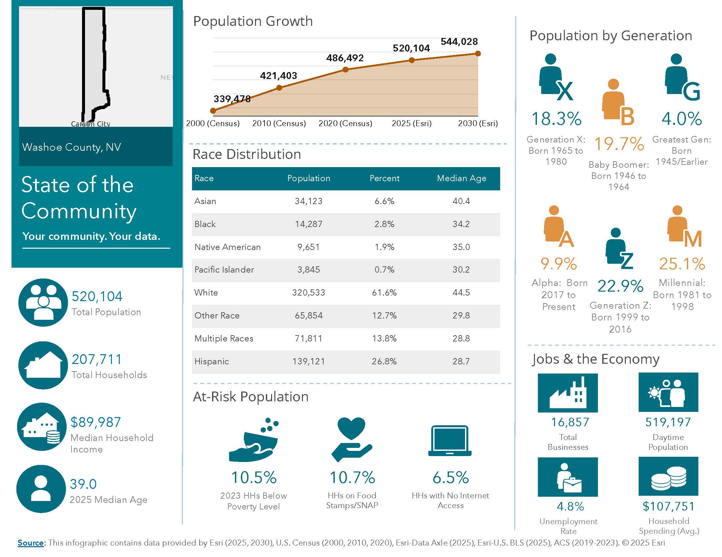
Demographics

Slide 45
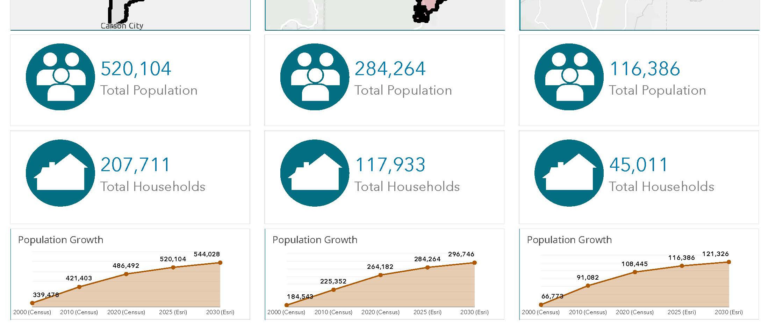
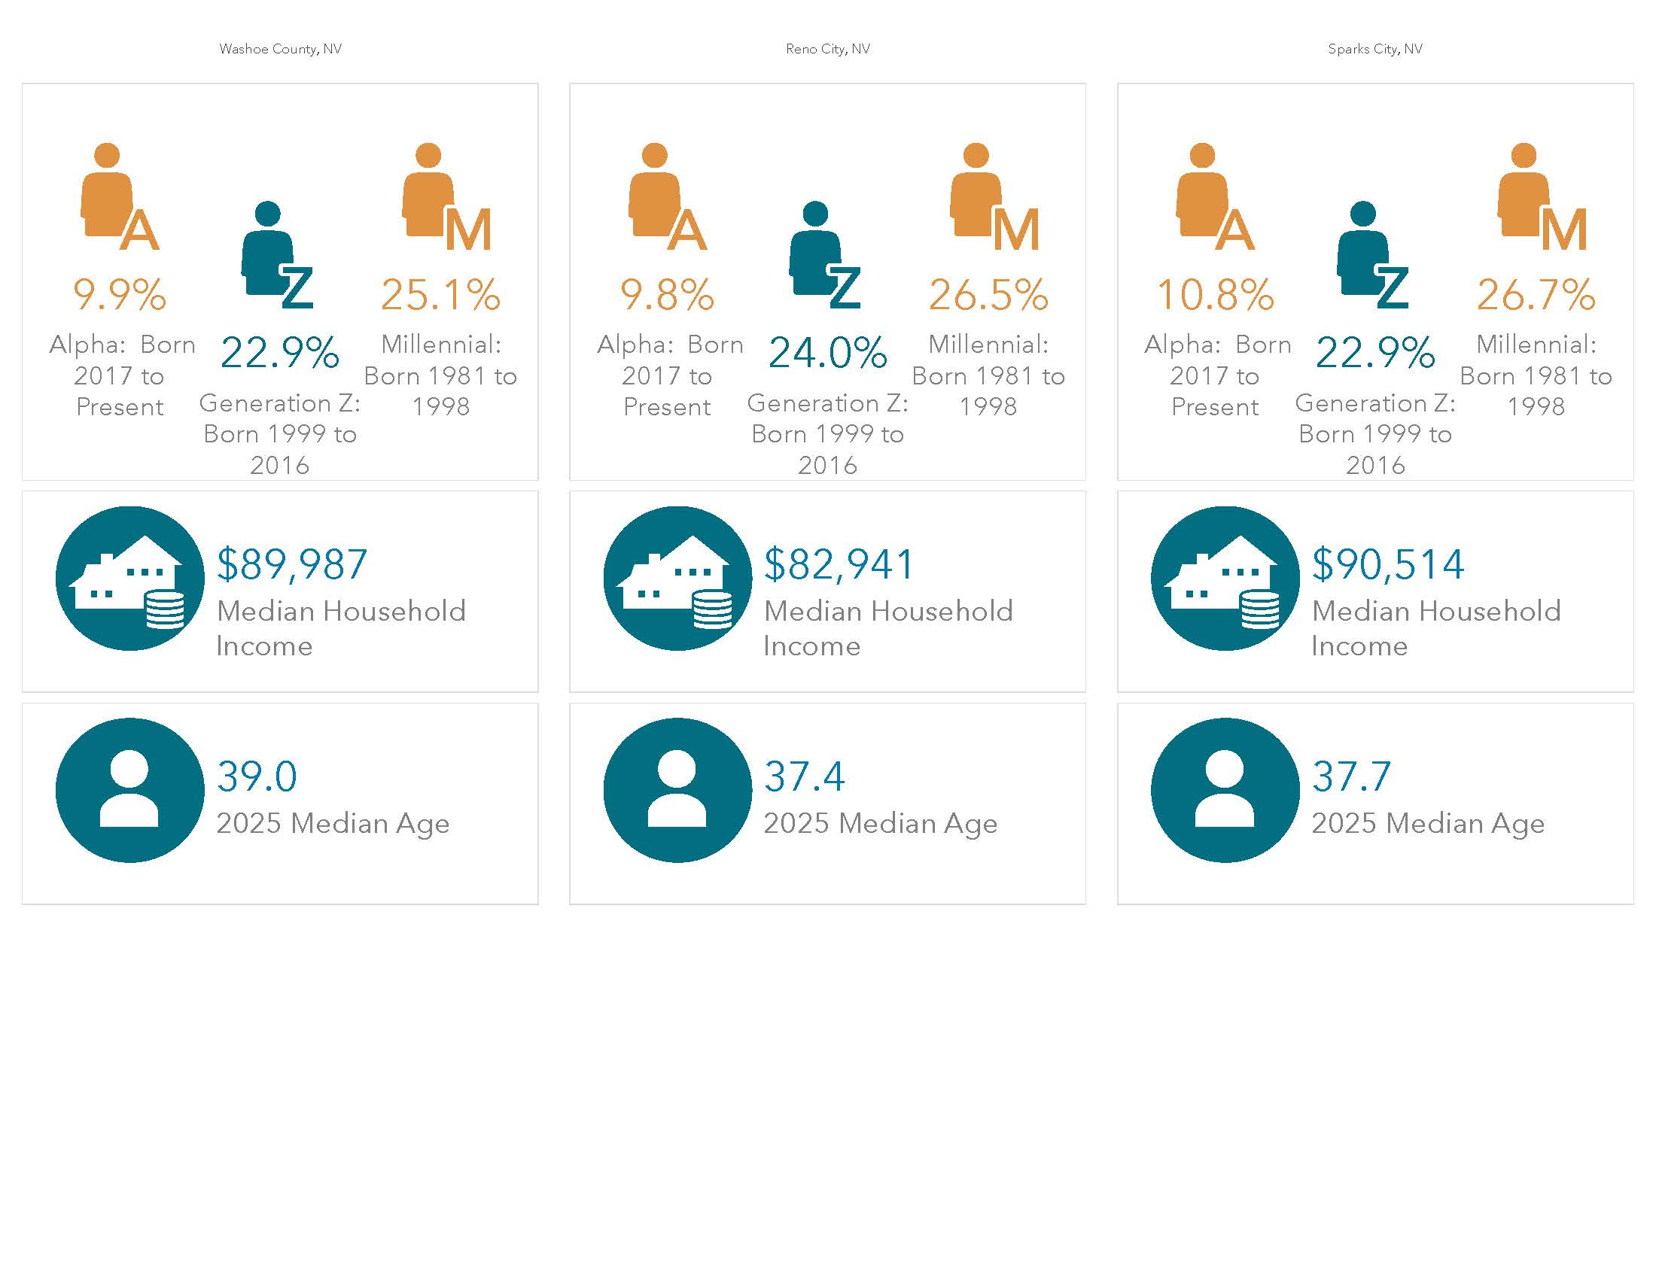
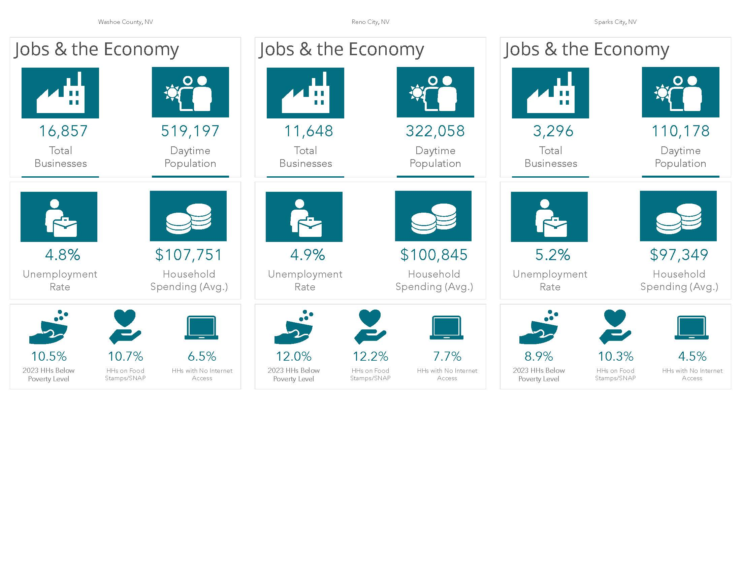
Washoe County
Reno
Sparks
Demographics

Slide 46
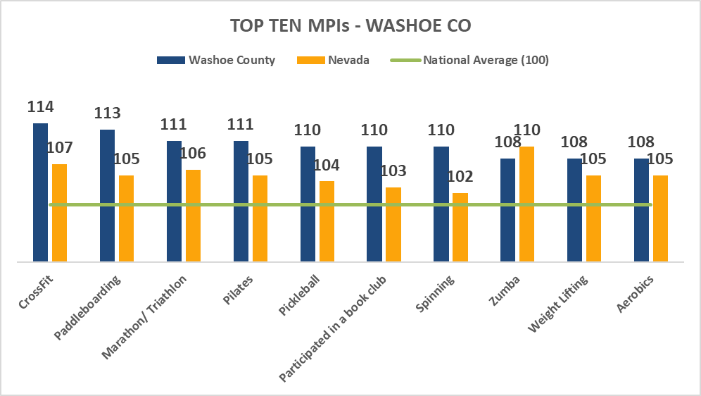
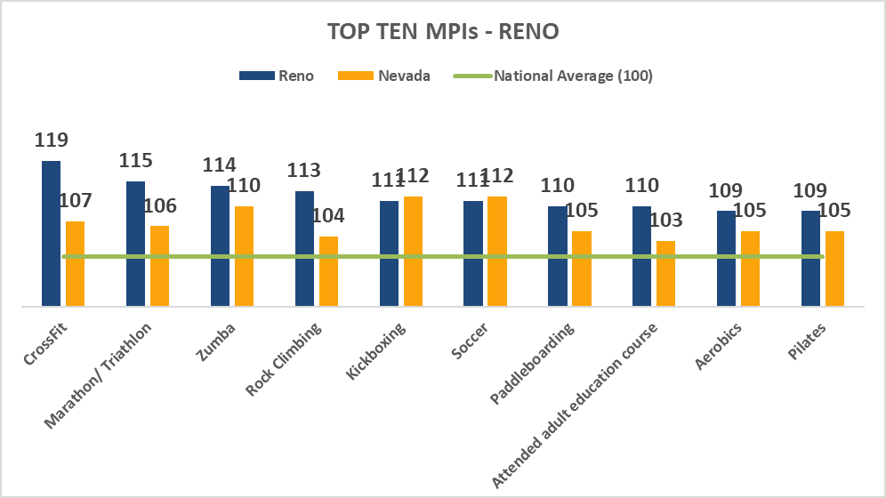
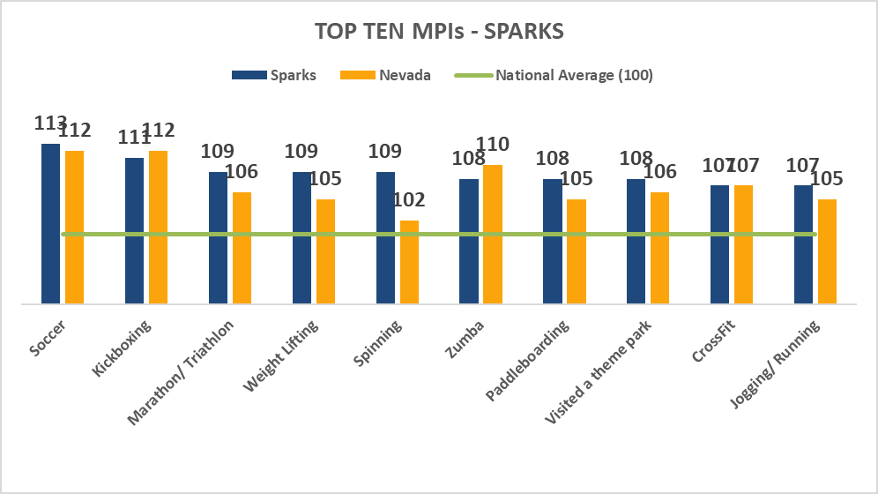
Recreation Trends

